Slide 1
COX Operational Reporting Updates
09/27/2024

Slide 2
Status Summary – WO 23rd Sept: CIAM Program
Task Progress | Data Engineering: Created Fact tables in Athena & Uploaded in S3 [CIAM_DATAMODEL Schema] Sanity checks done on the fact tables to align on data range understood. Combine tables for Metric calculation and BI development BI Development: Wireframe creation & re-alignment Validation of columns from Fact tables, aligning to Profile & Activity. Combine tables for Metric calculation and visualization
Plan for next 2 weeks | Data Engineering: Support to BI development for metric tables and calculations. Creating Partition – External table in Athena ETL Pipeline BI Development: Using Quick Sight for metric validation Mapping questions ( Vision house pillar & Additional business questions) to metrics Profile visualization creation in Excel.
Requirement | Data Engineering: Need inputs on the source to update the empty columns, currently kept as placeholder. Rules for certain columns like Activity name, User permissions & authentication error.
Challenges | Data Engineering: EDS Accesses in AI COE Sandbox, to perform ETL pipeline and Partition on external table in Athena. Creating Lags in project timelines. Access to Tableau. Need Knowledge worker role for eClerx. Excel file in browser has limit with certain number of updates and file size. Making it difficult for working. Limited metrics available to show good progress.

Slide 3
Status Summary – WO 23rd Sept: Commercial Dashboard
Task Progress | Data Engineering: Created table in Athena for CB profile metrics Created table in Athena for Adoption and Containment. Optimizing query in progress.
Plan for next 2 weeks | Data Engineering: Creating Final query with Date range and historical data. [Need to discuss with Praveen for below options] Upload data in S3 Create external table in Athena Load historical data [2023 & 2024] Create data pipeline for processing Create schedulers Tableau view creation
Requirement: | Confirmation on Date range.

Slide 4
Status Summary – WO 23rd Sept: Health Scorecard
Task Progress | BI Development Understanding the Excel sheet Formula and calculations interpretation Sample metric visualization development Creating Yesterday column for all metrics Developing color indicators basis Standard Deviation/ Yesterday in progress
Plan for next weeks | Creating 7 days and 30 days calculation for all metric Aesthetic enhancements– Tone down the blue, trend lines to be wider, make the labels readable
Challenges | Access to Tableau. Need Knowledge worker role for eClerx.

Slide 6
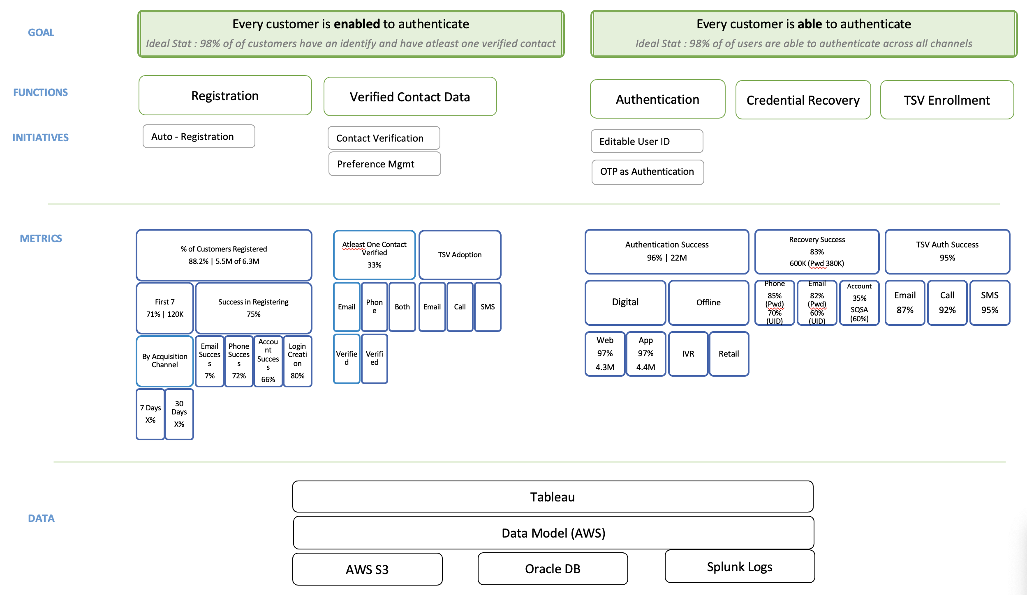
CIAM - Functions, Initiatives and Metrics

Slide 7
Projects in Pipeline
Operational Health Scorecards (Digital Health and Behavior)
Migrate excel based ‘residential mobile app’ scorecard to tableau
New scorecard for ‘residential web’ in tableau
New scorecard for ‘commercial web’ in tableau
Campaign Performance Scorecard
Build data layer for reporting and modelling purposes
Adobe data
CRM data

Slide 8
Internal Org
Eric Pace
(Digital)
Matt Earnest
Elliot Schwartz
AI & Analytics
Richard Brown
eClerx
Praveen
Eric owns all digital asserts for cox communications for residential and commercial business
The AI& Analytics org manages AI initiatives and end to end digital analytics for Eric’s org including Sales and Self-service
Matt owns all self-service functions (current customer) including CIAM
Elliot owns end to end CIAM Program in partnership with Technology & Security
Richard owns end to end digital analytics for Eric’s org
Praveen manages analytics for all self-service functions for Matt’s org

